Slide 1
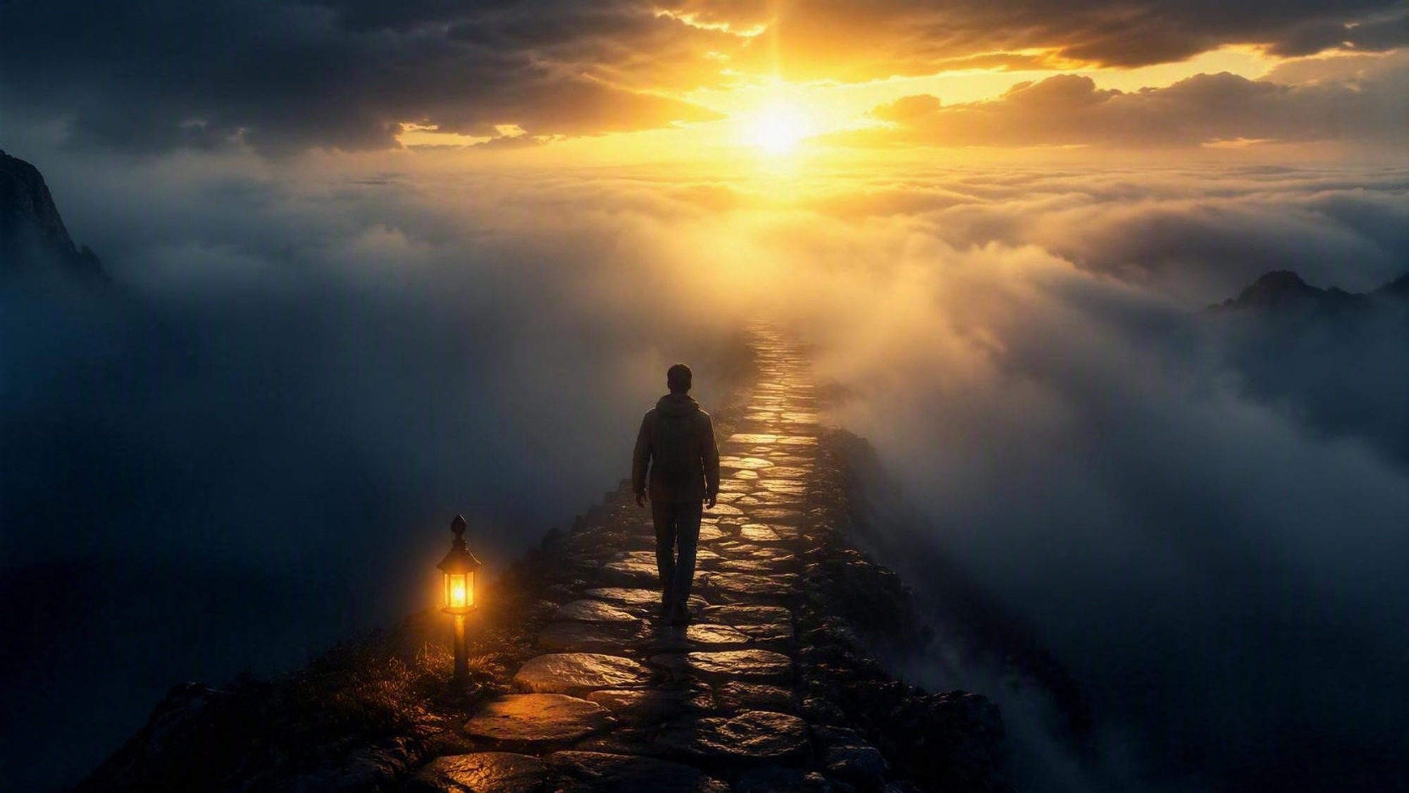
Walking by Faith and
Not by Sight
II Corinthians 5:7

Slide 2
Getting Comfortable with the Uncomfortable
II Corinthians 4:17 - 5:10

Slide 3
II Corinthians 5:7 (NKJV)
For we walk by faith,
not by sight

Slide 4
II Corinthians 4:17–5:10 (NKJV)
Trebuchet MS (Body)
Minimum size = 54
Transition beginning of scripture = Doors
Transition subsequent pages = Page Curl

Slide 5
II Corinthians 4:17–5:10 (NKJV)
¹⁷ For our light affliction, which is but for a moment, is working for us a far more exceeding and eternal weight of glory,
¹⁸ while we do not look at the things which are seen, but at the things which are not seen.

Slide 6
II Corinthians 4:17–5:10 (NKJV)
For the things which are seen are temporary, but the things which are not seen are eternal.
¹ For we know that if our earthly house, this tent, is destroyed, we have a building from God, a house not made with hands, eternal in the heavens.

Slide 7
II Corinthians 4:17–5:10 (NKJV)
² For in this we groan, earnestly desiring to be clothed with our habitation which is from heaven,
³ if indeed, having been clothed, we shall not be found naked.

Slide 8
II Corinthians 4:17–5:10 (NKJV)
⁴ For we who are in this tent groan, being burdened, not because we want to be unclothed, but further clothed, that mortality may be swallowed up by life.

Slide 9
II Corinthians 4:17–5:10 (NKJV)
⁵ Now He who has prepared us for this very thing is God, who also has given us the Spirit as a guarantee.
⁶ So we are always confident, knowing that while we are at home in the body we are absent from the Lord.

Slide 10
II Corinthians 4:17–5:10 (NKJV)
⁷ For we walk by faith, not by sight. ⁸ We are confident, yes, well pleased rather to be absent from the body and to be present with the Lord.
⁹ Therefore we make it our aim, whether present or absent, to be well pleasing to Him.

Slide 11
II Corinthians 4:17–5:10 (NKJV)
¹⁰ For we must all appear before the judgment seat of Christ, that each one may receive the things done in the body, according to what he has done, whether good or bad.

Slide 12
What the Bible Says About Our Comfort:
We All Face Struggles, But Faith Reframes Them

Slide 13
Romans 8:28 (NASB)
And we know that God causes all things to work together for good to those who love God, to those who are called according to His purpose.

Slide 14
I Peter 1:6–7 (NASB)
⁶ In this you greatly rejoice, even though now for a little while, if necessary, you have been distressed by various trials,

Slide 15
I Peter 1:6–7 (NASB)
⁷ so that the proof of your faith, being more precious than gold which is perishable, even though tested by fire, may be found to result in praise and glory and honor at the revelation of Jesus Christ;

Slide 16
Hebrews 13:5 (KJV)
Let your conversation be without covetousness; and be content with such things as ye have: for he hath said, I will never leave thee, nor forsake thee.

Slide 17
What the Bible Says About Our Comfort:
Walking by Faith Feels Uncomfortable, but It’s Actually the More Certain Path

Slide 18
Hebrews 11:1 (KJV)
Now faith is the substance of things hoped for, the evidence of things not seen

Slide 19
Romans 8:24–25 (NASB)
²⁴ For in hope we have been saved, but hope that is seen is not hope; for who hopes for what he already sees?
²⁵ But if we hope for what we do not see, with perseverance we wait eagerly for it.

Slide 20
John 20:29 (NASB)
Jesus said to him, "Because you have seen Me, have you believed? Blessed are they who did not see, and yet believed."

Slide 21
What the Bible Says About Our Comfort:
Walking by Faith Must Become Our Lifestyle, Not Our Emergency Plan

Slide 22
Romans 12:2 (NASB)
And do not be conformed to this world, but be transformed by the renewing of your mind, so that you may prove what the will of God is, that which is good and acceptable and perfect.

Slide 23
I Corinthians 2:5 (NASB)
so that your faith would not rest on the wisdom of men,
but on the power of God.

Slide 24
Colossians 2:6-7 (NASB)
⁶ Therefore as you have received Christ Jesus the Lord, so walk in Him, ⁷ having been firmly rooted and now being built up in Him and established in your faith, just as you were instructed, and overflowing with gratitude.

Slide 25
Get Comfortable Walking by Faith
Struggles are real — but temporary
Sight is shaky — but faith is steady
Faith grows — and becomes a lifestyle
Your faith becomes a witness — and strengthens others

Slide 26
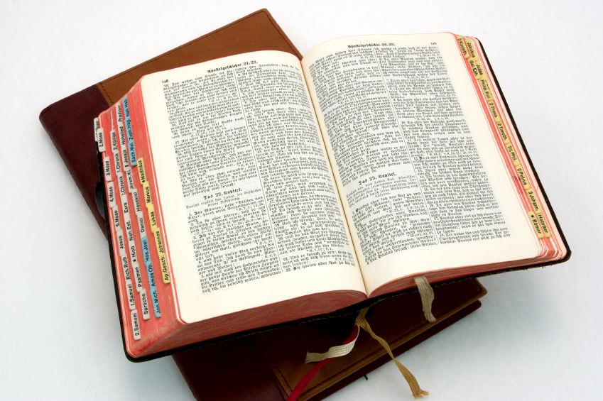
Hear: Romans 10:17
So then faith cometh by hearing, and hearing by the word of God.

Slide 27
Believe: Hebrews 11:6
But without faith it is impossible to please him: for he that cometh to God must believe that he is, and that he is a rewarder of them that diligently seek him.

Slide 28
Repent: Luke 13:3
I tell you, Nay: but, except ye repent, ye shall all likewise perish.

Slide 29
Confess: Matthew 10:32-33
32 Whosoever therefore shall confess me before men, him will I confess also before my Father which is in heaven.
33 But whosoever shall deny me before men, him will I also deny before my Father which is in heaven.

Slide 30
Baptize: Acts 22:16
And now why tarriest thou? arise, and be baptized, and wash away thy sins, calling on the name of the Lord.

Slide 31
Your Comfort Becomes Their Comfort
II Corinthians 5:14 - 15

Slide 32
II Corinthians 5:14–15 (NKJV)
¹⁴ For the love of Christ compels us, because we judge thus: that if One died for all, then all died;
¹⁵ and He died for all, that those who live should live no longer for themselves, but for Him who died for them and rose again.

Slide 33
What the Bible Says About Their Comfort:
Peace Becomes Visible

Slide 34
Colossians 3:15 (NKJV)
And let the peace of God rule in your hearts, to which also you were called in one body; and be thankful.

Slide 35
Proverbs 3:5–6 (NKJV)
⁵ Trust in the LORD with all your heart, And lean not on your own understanding;
⁶ In all your ways acknowledge Him, And He shall direct your paths.

Slide 36
Psalm 37:7 (ESV)
Be still before the Lord and wait patiently for Him.

Slide 37
What the Bible Says About Their Comfort:
Your Life Is Light

Slide 38
Matthew 5:14–16 (KJV)
¹⁴ Ye are the light of the world. A city that is set on an hill cannot be hid.
¹⁵ Neither do men light a candle, and put it under a bushel, but on a candlestick; and it giveth light unto all that are in the house.

Slide 39
Matthew 5:14–16 (KJV)
¹⁶ Let your light so shine before men, that they may see your good works, and glorify your Father which is in heaven.

Slide 40
Proverbs 4:18 (NKJV)
But the path of the just is like the shining sun, That shines ever brighter unto the perfect day.

Slide 41
Psalm 112:4 (ESV)
Light dawns in the darkness for the upright; he is gracious, merciful, and righteous.

Slide 42
What the Bible Says About Their Comfort:
Others Are Watching Your Endurance

Slide 43
Hebrews 12:1–2 (NASB)
¹ Therefore, since we have so great a cloud of witnesses surrounding us, let us also lay aside every encumbrance and the sin which so easily entangles us, and let us run with endurance the race that is set before us,

Slide 44
Hebrews 12:1–2 (NASB)
² fixing our eyes on Jesus, the author and perfecter of faith, who for the joy set before Him endured the cross, despising the shame, and has sat down at the right hand of the throne of God.

Slide 45
Ecclesiastes 7:8 (NASB)
The end of a matter is better than its beginning; Patience of spirit is better than haughtiness of spirit.

Slide 46
Proverbs 24:16 (NASB)
For a righteous man falls seven times, and rises again, But the wicked stumble in time of calamity.

Slide 47
Your faith becomes their strength
Your walk becomes their encouragement
Your example becomes their invitation to trust God

Slide 48
Hear: Romans 10:17
So then faith cometh by hearing, and hearing by the word of God.

Slide 49
Believe: Hebrews 11:6
But without faith it is impossible to please him: for he that cometh to God must believe that he is, and that he is a rewarder of them that diligently seek him.

Slide 50
Repent: Luke 13:3
I tell you, Nay: but, except ye repent, ye shall all likewise perish.

Slide 51
Baptize: Acts 22:16
And now why tarriest thou? arise, and be baptized, and wash away thy sins, calling on the name of the Lord.

